Slide 1
Customer data analysis
Year 2021-2023

Slide 2
Task – 1
Shopping distribution according to gender.
Gender | Total Revenue | Quantity Purchased | Avg Revenue per Transaction | Number of Transactions
Female | ₹150.2 Million | 178,659 | ₹2,525.25 | 59,482
Male | ₹101.3 Million | 120,053 | ₹2,534.05 | 39,975
Female customers contributed approximately 48% more revenue than male customers.
They made about 49% more transactions compared to males.
The average revenue per transaction is almost identical between genders, indicating similar purchasing power per visit.

Slide 3
Task – 2
Which gender did we sell more products to?
Gender | Product quantity
Female | 178659
Male | 120053
Grand Total | 298712
This confirms that Female customers purchased significantly more products overall, aligning with the higher number of transactions and total revenue.

Slide 4
Task - 3
Which gender generated more revenue?
Gender | Total Revenue
Female | ₹ 15,02,07,136.02
Male | ₹ 10,12,98,658.23
Grand Total | ₹ 25,15,05,794.25
Explanations:-
Female customers generated more revenue. (150 million)

Slide 5
Task - 4
Distribution of purchase categories relative to other columns?
1. Category vs Gender wise product quantity
Category | Female | Male
Clothing | 62039 | 41519
Cosmetics | 27261 | 18204
Food & Beverage | 26362 | 17915
Toys | 18362 | 11959
Shoes | 17906 | 12311
Technology | 8977 | 6044
Books | 8776 | 6206
Souvenir | 8976 | 5895
Grand Total | 178659 | 120053

Slide 6
Task - 4
Distribution of purchase categories relative to other columns?
1. category wise revenue generated
Category | Revenue
Clothing | 113996791
Shoes | 66553451.47
Technology | 57862350
Cosmetics | 6792862.9
Toys | 3980426.24
Food & Beverage | 849535.05
Books | 834552.9
Souvenir | 635824.65
Grand Total | 251505794.2

Slide 7
Task - 4
Distribution of purchase categories relative to other columns?
1. Age group and category wise quantity sold

Slide 8
Task - 5
Shopping distribution according to age.
Age group wise revenue generated
Age group wise quantity sold
Age group | revenue
18-30 | 63047402.11
41-50 | 48779846.58
31 -40 | 48370413.32
51-60 | 47788662.58
60 -70 | 43519469.66
Age group | Sum of quantity
18-30 | 75172
31 -40 | 57850
41-50 | 57156
51-60 | 56997
60 -70 | 51537

Slide 9
Task - 5
Shopping distribution according to age.
Age_group related to the quantity sold by the category
Age group | 18-30 | 31 -40 | 41-50 | 51-60 | 60 -70
Clothing | 26094 | 19694 | 20083 | 19849 | 17838
Cosmetics | 11203 | 8987 | 8579 | 8829 | 7867
Food & Beverage | 11051 | 8864 | 8354 | 8441 | 7567
Shoes | 7684 | 5771 | 5863 | 5665 | 5234
Toys | 7853 | 5682 | 5791 | 5632 | 5363
Technology | 3681 | 3017 | 2913 | 2817 | 2593
Souvenir | 3767 | 2954 | 2754 | 2902 | 2494
Books | 3839 | 2881 | 2819 | 2862 | 2581

Slide 10
Task - 6
Which age cat did we sell more products to?
we sell more products to 18-30 age category

Slide 11
Task - 7
Which age cat generated more revenue?
18 t0 30 age category generated more revenue other than .

Slide 12
Task - 9
Does the payment method have a relation with other columns?
age group wise total transaction
Payment method | Cash | Credit Card | Debit Card | Grand Total
18-30 | 11177 | 8785 | 5062 | 25024
31 -40 | 8618 | 6771 | 3877 | 19266
41-50 | 8464 | 6700 | 3902 | 19066
51-60 | 8423 | 6630 | 3879 | 18932
60 -70 | 7765 | 6045 | 3359 | 17169
Grand Total | 44447 | 34931 | 20079 | 99457

Slide 13
Task - 9
Does the payment method have a relation with other columns?
Payment method related to category and revenue
Category | revenue
Payment method | Cash | Credit Card | Debit Card
Clothing | 51308879 | 39351591 | 23336321
Shoes | 29782836 | 23560874 | 13209742
Technology | 25937100 | 20493900 | 11431350
Cosmetics | 2962691 | 2454604 | 1375568
Toys | 1810601 | 1403494 | 766331
Books | 379947 | 280608 | 173998
Food & Beverage | 375708 | 302943 | 170885
Souvenir | 274482 | 229110 | 132232

Slide 14
Task - 10
How is the distribution of the payment method?
Payment Method | Total Quantity | Total Revenue (₹) | Transaction Count
Cash | 133,370 | ₹112.83 million | 44,447
Credit Card | 105,045 | ₹88.08 million | 34,931
Debit Card | 60,297 | ₹50.60 million | 20,079
Insights:
Cash is the most used payment method in terms of quantity sold, revenue, and transactions.
Credit Card ranks second, showing strong usage for higher-value purchases.
Debit Card has the lowest usage in all three metrics.

Slide 15
Visualize the data using PowerBI

Slide 16
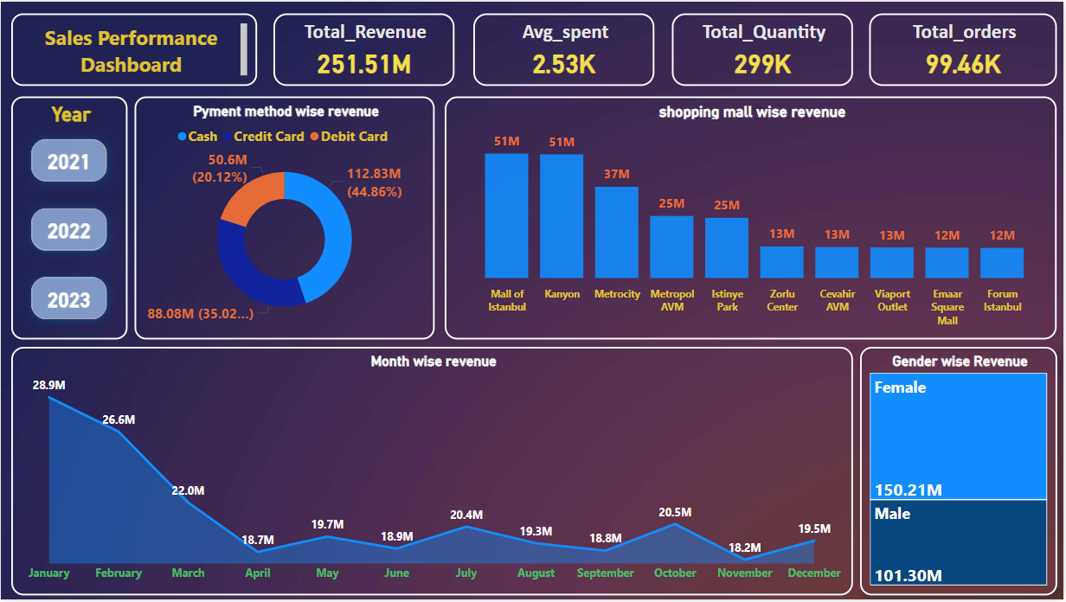

Slide 17
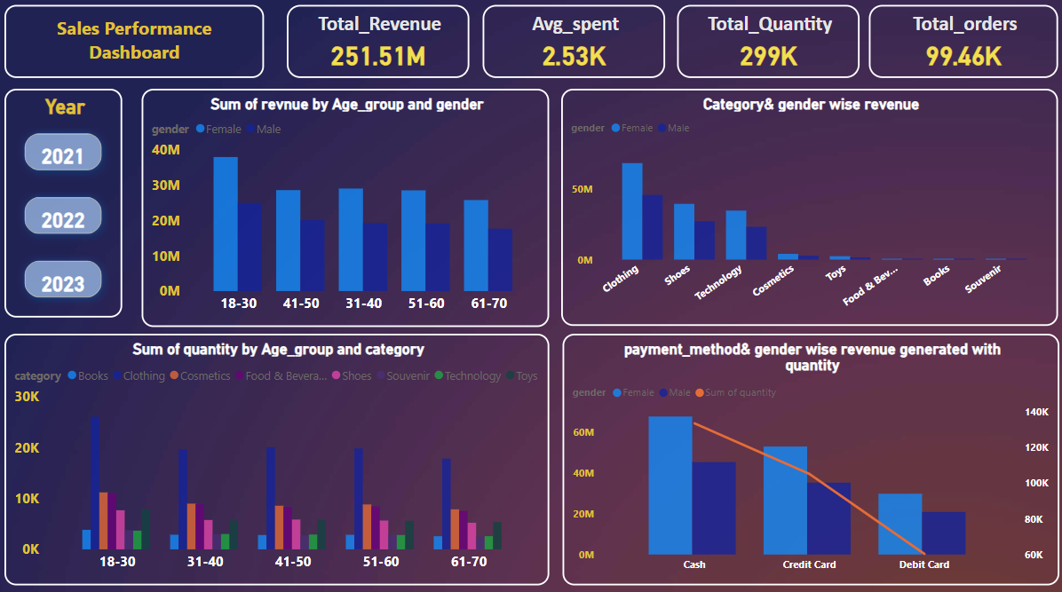

Slide 18
Sales Performance Dashboard Insights
Comprehensive Analysis Based on Dashboard Visuals

Slide 19
Key Performance Indicators (KPIs)
• Total Revenue: $251.51M
• Average Spent per Order: $2.53K
• Total Quantity Sold: 299K
• Total Orders: 99.46K

Slide 20
Gender-wise Revenue Insights
• Female customers generated higher revenue: $150.21M
• Male customers generated $101.30M
• Female customers show stronger purchasing behavior across most age groups and categories.

Slide 21
Age Group and Gender-wise Revenue
• 18–30 age group leads in revenue, especially among females (~$40M).
• Revenue is more consistent across other age groups but slightly declines with age.

Slide 22
Category & Gender-wise Revenue
• Top performing categories:
- Clothing: >$50M (dominant among females)
- Shoes and Technology also perform well
• Cosmetics, Toys, Books, Souvenirs contribute marginally.

Slide 23
Quantity Sold by Age Group & Category
• Clothing is the most sold category across all age groups.
• Other frequently purchased items include Cosmetics and Technology.
• Distribution of purchases remains steady across age brackets.

Slide 24
Payment Method Analysis
• Most preferred payment method: Cash (44.86%)
• Credit Cards follow (35.02%), then Debit Cards (20.12%)
• Female users dominate revenue in all payment methods.

Slide 25
Shopping Mall-wise Revenue
• Top Malls: Mall of Istanbul and Kanyon each at $51M
• Metrocity, Metropol AVM, and Istinye Park follow with ~$25M–$37M
• Others generate around $12M–$13M

Slide 26
Month-wise Revenue Trend
• Highest Revenue in January: $28.9M
• Notable drop in April and steady performance afterward
• Small peaks in July and October (~$20.5M)

Slide 27
Strategic Recommendations
• Focus on female-targeted campaigns, especially in Clothing and Shoes.
• Enhance promotions for the 18–30 age group.
• Promote cash payment incentives in top-performing malls.
• Plan for revenue dips during April–June with seasonal offers.

Slide 28
THANK YOU

